Slide 1


When there’s solute …
A(g)
A(g)
${P_{A}<P}_{A}^{∗}$
$P_{A}^{∗}$
A
A
New equilibrium
A
A
Add solute B
Equilibrium
B
A
A
A
A
A
A
A
A
B
A(l) with dissolved B
Pure A(l)
A
A
A
A
The vapor pressure of the gaseous form of a solvent in equilibrium with a solution ($P_{A}$) will be less than it would be above the pure solvent ($P_{A}^{∗}$).

Slide 2

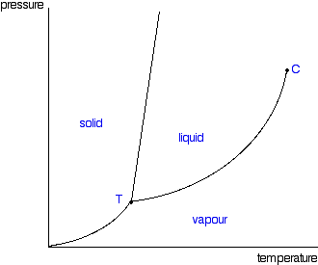


When there’s solute …
P
A(g)
${P_{A}<P}_{A}^{∗}$
A
New equilibrium
A
$$P_{A}^{∗}$$
B
A
A
A
A
B
$$P_{A}$$
A(l) with dissolved B
A
A
T
The vapor pressure of the gaseous form of a solvent in equilibrium with a solution ($P_{A}$) will be less than it would be above the pure solvent ($P_{A}^{∗}$).

Slide 3
Raoult’s Law
${P_{A}=P}_{A}^{∗}χ_{A}$
P
A(g)
${P_{A}<P}_{A}^{∗}$
A
New equilibrium
A
$$P_{A}^{∗}$$
B
A
A
A
A
B
$$P_{A}$$
A(l) with dissolved B
A
A
T
Here, $χ_{A}$ is the mole fraction of A in the solution,
$χ_{A}≡\frac{n_{A}}{n_{A}+n_{B}}$. A handy formula: $χ_{A}=\frac{1}{1+M_{A}b_{B}}$ where $b_{B}≡\frac{mol B}{kg A}$ is the solute’s molality (demo).

Slide 4
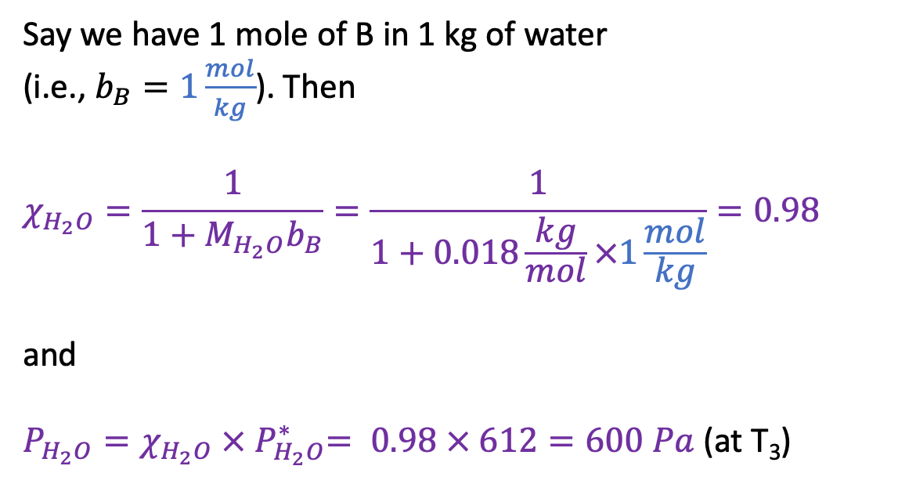
Example Raoult’s Law calculation
P
Say we have 1 mole of B in 1 kg of water
(i.e., $b_{B}=1\frac{mol}{kg}$). Then
$$χ_{H_{2}O}=\frac{1}{1+M_{H_{2}O}b_{B}}=\frac{1}{1+0.018\frac{kg}{mol}×1\frac{mol}{kg}}=0.98$$
and
$P_{H_{2}O}=χ_{H_{2}O} {× P}_{H_{2}O}^{∗}= 0.98 × 612=600 Pa$ (at T₃)
$$P_{A}^{∗}$$
612 Pa
$$P_{A}$$
600 Pa
T

Slide 5

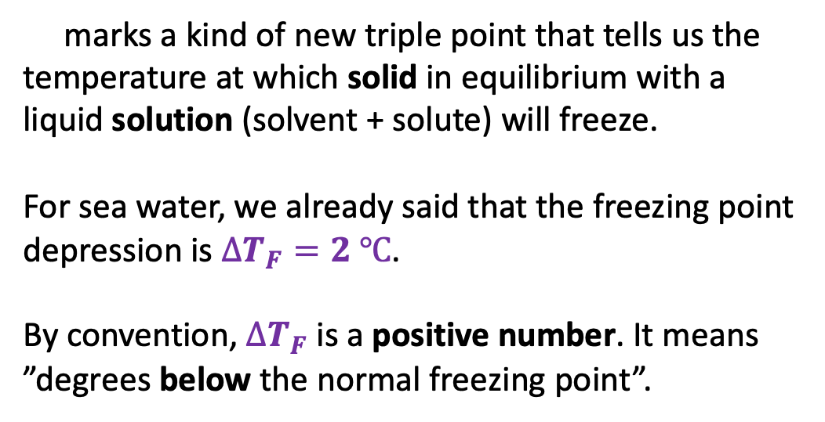
Raoult’s Law and freezing point depression
P
marks a kind of new triple point that tells us the temperature at which solid in equilibrium with a liquid solution (solvent + solute) will freeze.
For sea water, we already said that the freezing point depression is $∆T_{F}=2 ℃$.
By convention, $∆T_{F}$ is a positive number. It means ”degrees below the normal freezing point”.
$$P_{A}^{∗}$$
$$P_{A}$$
$$∆T_{F}$$
T

Slide 6

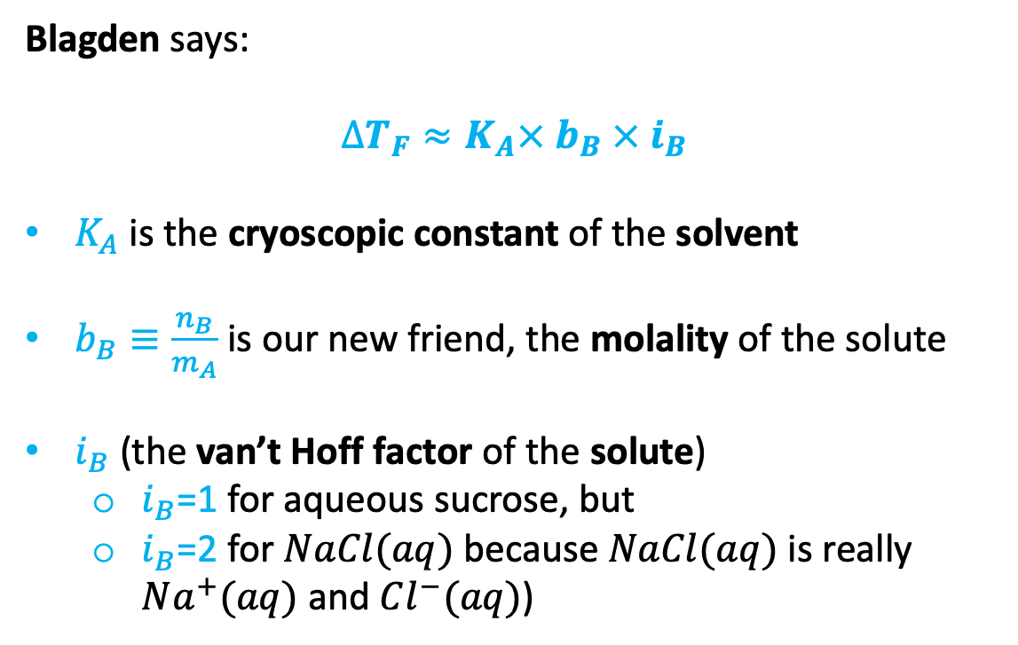
Blagden’s Law for freezing point depression
Blagden says:
$$∆T_{F}≈K_{A}× b_{B} × i_{B}$$
$K_{A}$ is the cryoscopic constant of the solvent
$b_{B}≡\frac{n_{B}}{m_{A}}$ is our new friend, the molality of the solute
$i_{B}$ (the van’t Hoff factor of the solute)
$i_{B}$=1 for aqueous sucrose, but
$i_{B}$=2 for $NaCl(aq)$ because $NaCl(aq)$ is really $Na^{+}(aq)$ and $Cl^{−}(aq)$)
P
$$P_{A}^{∗}$$
$$P_{A}$$
$$∆T_{F}$$
T

Slide 7


Blagden’s Law for freezing point depression
Blagden says:
$$∆T_{F}≈K_{A}× b_{B} × i_{B}$$
$K_{A}$ is the cryoscopic constant of the solvent
$b_{B}≡\frac{n_{B}}{m_{A}}$ is our new friend, the molality of the solute
$i_{B}$ (the van’t Hoff factor of the solute)
$i_{B}$=1 for aqueous sucrose, but
$i_{B}$=2 for $NaCl(aq)$ because $NaCl(aq)$ is really $Na^{+}(aq)$ and $Cl^{−}(aq)$)
P
$$P_{A}^{∗}$$
$$P_{A}$$
$$∆T_{F}$$
T
Hypothesis: there’s a connection between Blagden and Raoult.
How to explore that hypothesis: use ${P_{A}=P}_{A}^{∗}χ_{A}$ to deduce $∆T_{F}≈K_{A}× b_{B} × i_{B}$.

Slide 8
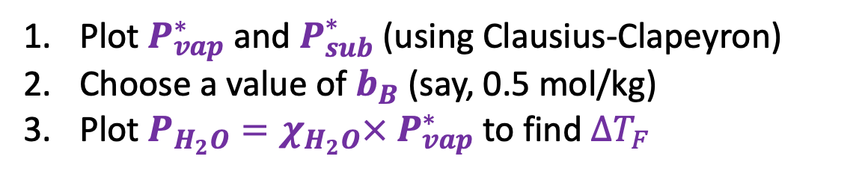
Using Raoult’s Law to deduce Blagden’s Law
P
Plot $P_{vap}^{∗}$ and $P_{sub}^{∗}$ (using Clausius-Clapeyron)
Choose a value of $b_{B}$ (say, 0.5 mol/kg)
Plot $P_{H_{2}O}=χ_{H_{2}O}×{ P}_{vap}^{∗}$ to find $∆T_{F}$
$$P_{A}^{∗}$$
$$P_{A}$$
$$∆T_{F}$$
T

Slide 9
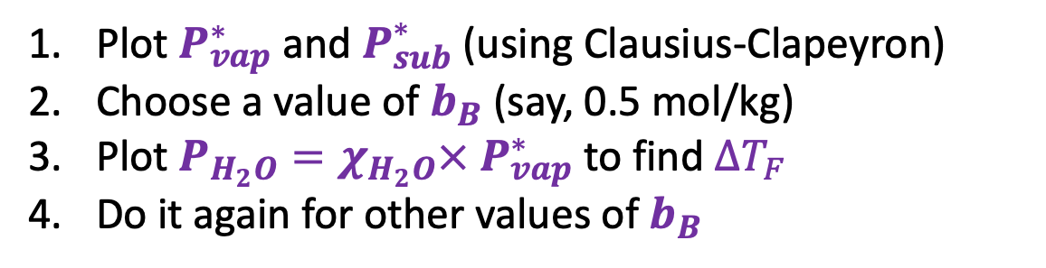
Using Raoult’s Law to deduce Blagden’s Law
P
Plot $P_{vap}^{∗}$ and $P_{sub}^{∗}$ (using Clausius-Clapeyron)
Choose a value of $b_{B}$ (say, 0.5 mol/kg)
Plot $P_{H_{2}O}=χ_{H_{2}O}×{ P}_{vap}^{∗}$ to find $∆T_{F}$
Do it again for other values of $b_{B}$
$$P_{A}^{∗}$$
$$P_{A}$$
$$∆T_{F}$$
T

Slide 10
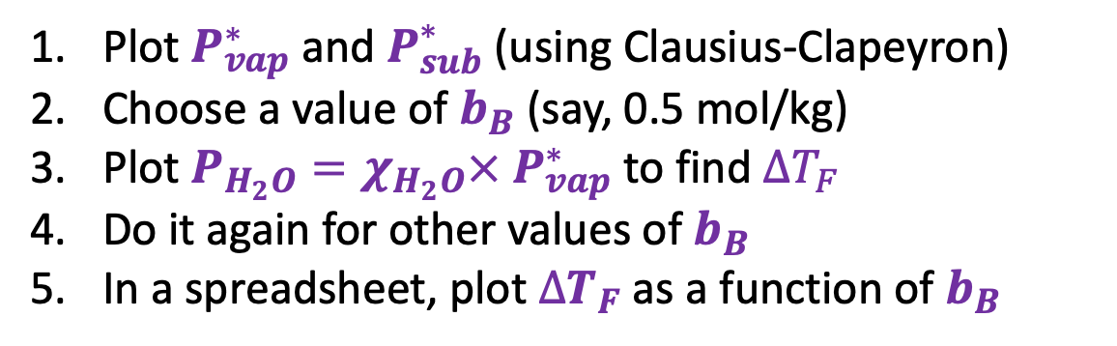


Using Raoult’s Law to deduce Blagden’s Law
P
Plot $P_{vap}^{∗}$ and $P_{sub}^{∗}$ (using Clausius-Clapeyron)
Choose a value of $b_{B}$ (say, 0.5 mol/kg)
Plot $P_{H_{2}O}=χ_{H_{2}O}×{ P}_{vap}^{∗}$ to find $∆T_{F}$
Do it again for other values of $b_{B}$
In a spreadsheet, plot $∆T_{F}$ as a function of $b_{B}$
$$P_{A}^{∗}$$
$$P_{A}$$
$∆T_{F}$
$$∆T_{F}$$
T
$$b_{B}$$

Slide 11
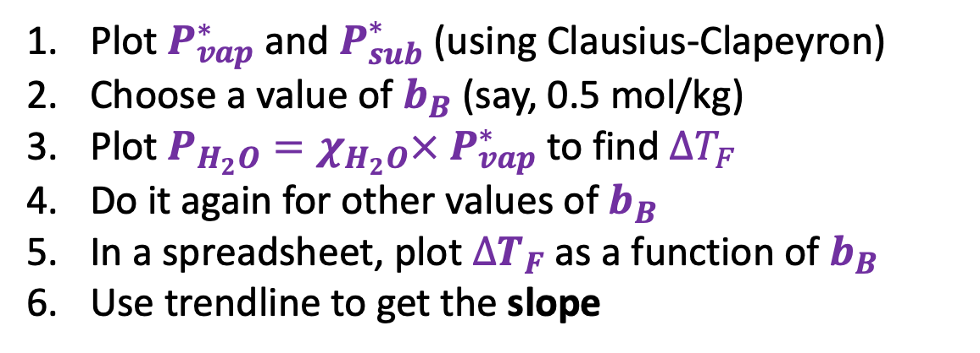
Using Raoult’s Law to deduce Blagden’s Law
P
Plot $P_{vap}^{∗}$ and $P_{sub}^{∗}$ (using Clausius-Clapeyron)
Choose a value of $b_{B}$ (say, 0.5 mol/kg)
Plot $P_{H_{2}O}=χ_{H_{2}O}×{ P}_{vap}^{∗}$ to find $∆T_{F}$
Do it again for other values of $b_{B}$
In a spreadsheet, plot $∆T_{F}$ as a function of $b_{B}$
Use trendline to get the slope
$$P_{A}^{∗}$$
$$P_{A}$$
$∆T_{F}$
$$∆T_{F}$$
T
$$b_{B}$$

Slide 12

Using Raoult’s Law to deduce Blagden’s Law
P
Plot $P_{vap}^{∗}$ and $P_{sub}^{∗}$ (using Clausius-Clapeyron)
Choose a value of $b_{B}$ (say, 0.5 mol/kg)
Plot $P_{H_{2}O}=χ_{H_{2}O}×{ P}_{vap}^{∗}$ to find $∆T_{F}$
Do it again for other values of $b_{B}$
In a spreadsheet, plot $∆T_{F}$ as a function of $b_{B}$
Use trendline to get the slope
$$P_{A}^{∗}$$
$$P_{A}$$
$$∆T_{F}≈K_{A}× b_{B} × i_{B}$$
$∆T_{F}$
$$∆T_{F}$$
T
$$b_{B}$$

Slide 13

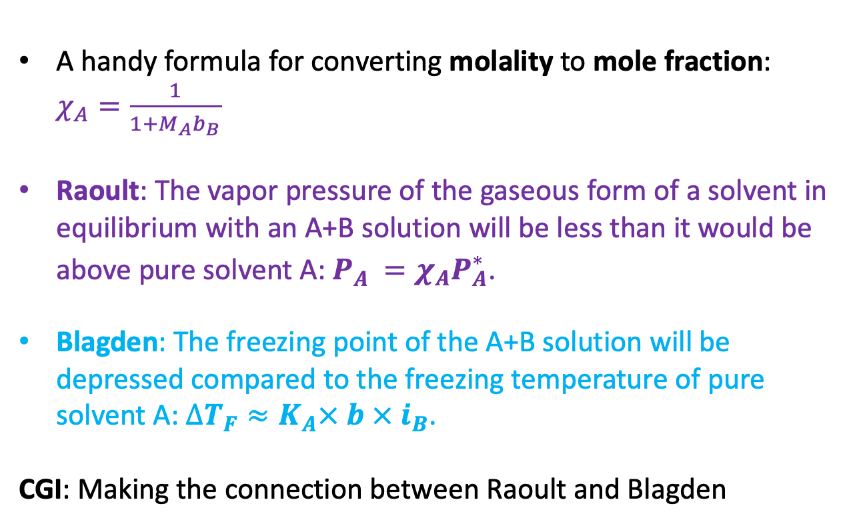


Summary
A handy formula for converting molality to mole fraction: $χ_{A}=\frac{1}{1+M_{A}b_{B}}$
Raoult: The vapor pressure of the gaseous form of a solvent in equilibrium with an A+B solution will be less than it would be above pure solvent A: $P_{A}^{}=χ_{A}P_{A}^{∗}$.
Blagden: The freezing point of the A+B solution will be depressed compared to the freezing temperature of pure solvent A: $∆T_{F}≈K_{A}× b × i_{B}$.
CGI: Making the connection between Raoult and Blagden
Raoult
${P_{A}<P}_{A}^{∗}$
A = solvent
B = solute
A
A
B
A
A
A
B
A
A
$∆T_{F}$
Blagden
$$b_{B}$$

